Slide 1
DROUGHT

Slide 2
OBJECTIVES
To provide the basic ideas behind the drought phenomenon.
To classify different types of drought.
To understand causes and impacts of drought.
How to manage drought.

Slide 3
G
L
O
S
S
A
R
Y
Absolute drought: In British climatology, a drought period of at least 15 days during which no measurable daily precipitation has fallen.
Agricultural drought: Conditions that result in adverse crop responses, usually because plants cannot meet potential transpiration as a result of high atmospheric demand and/or limited soil moisture.
Drought index: a numerical scale that scientists use to describe the severity of a drought. Scientists take many kinds of data (like stream flow, rainfall, temperature, and snowpack) and "blend" it into a single number, called a drought index value, to make it easier to understand the drought conditions of a particular area.
Drought: less rainfall than is expected over an extended period of time, usually several months or longer. Or, more formally, it is a deficiency of rainfall over a period of time, resulting in a water shortage for some activity, group, or environmental sector.
Dry spell: A period of precipitation below a specified amount. The specific period and amount of precipitation vary depending on the particular activity under discussion.
Hydrological drought: Prolonged period of below-normal precipitation, causing deficiencies in water supply, as measured by below-normal stream flow, lake and reservoir levels, groundwater levels, and depleted soil moisture content.

Slide 4
G
L
O
S
S
A
R
Y
Meteorological drought: meteorological events are weather events. Meteorological drought is the first stage of drought when the precipitation amount is less than normal for that region.
Mitigate: to reduce, lessen, or alleviate. Also used in terms of prevention of drought.
Palmer drought severity index: the PDSI was developed by Wayne Palmer in the 1960s and uses temperature and rainfall information in a formula to determine dryness. It has become the semi-official drought index.
Partial drought: In British climatology, a relative drought period of at least 29 consecutive days during which the average daily rainfall does not exceed 0.254 mm. An unusually rapid onset drought event characterized by a multi week period of accelerated intensification that culminates in impacts to one or more sectors (agricultural, hydrological, etc.).
Vulnerability: the extent to which changes could harm a system. In other words, it's the extent to which a community can be affected by the impact of a hazard such as drought.

Slide 5
Introduction to Drought
Drought is a temporary aberration, unlike aridity or even seasonal aridity (in terms of a well defined dry season), which is a permanent feature of climate. Drought in contrast is a recurrent, yet sporadic feature of climate, known to occur under all climatic regimes and is usually characterized by variability in terms of its spatial expanse, intensity and duration. Conditions of drought appear primarily, though not solely; on account of substantial rainfall deviation from the normal and / or the skewed nature of the spatial / temporal distribution to a degree that inflicts an adverse impact on crops over an agricultural season or successive seasons.
What is universally accepted is that drought stems from a deficiency or erratic distribution in rainfall but the spread and intensity of the calamity is contingent on several factors, including the status of surface and ground water resources, agro-climatic features, cropping choices and patterns, socio-economic vulnerabilities of the local population etc. It is difficult to provide a precise and universally accepted definition of drought due to its complex nature and varying characteristics that manifest across different agro-climatic regions of the world in a myriad different ways.

Slide 6
Drought differs from other natural in that:
There is no universally accepted definition that can encapsulate the complexity of this phenomenon adequately;
It is difficult to determine the beginning and end of a drought episode because of the slow, ‘creepy’ onset, silent spread and gradual withdrawal. In India, it is generally considered to be coterminous with the monsoons;
An episode could spill over months or even years with or without any accompanying shift in the geographical arena;
There is no indicator or index which can precisely forecast the advent and severity of a drought event, nor project its possible impacts;
Spatial expanse tends to be far greater than in the case of other natural calamities, which when compounded by the difficulties associated with the impact assessment of the disaster, makes effective response highly challenging;
The impact tends to get magnified in the event of successive droughts.

Slide 7
Classification of Drought
Based on the Study Perspective
Meteorological drought
Hydrological drought
Agricultural Drought
Socioeconomic Drought
Based on Period of Occurrence
Areas of permanent drought
Seasonal drought
Contingent drought

Slide 8
Based on the Study Perspective...
Meteorological drought
It is a situation where there is more than 25% decrease in precipitation from normal over an area.
The India Meteorological Department (IMD) has adopted the following criteria for sub-classification of meteorological droughts.
A meteorological sub-division is considered to be affected by drought if it receives a total seasonal rainfall less than that of 75% of the normal value.
Also, the drought is classified as moderate if the seasonal deficiency is between 26% and 50%. The drought is said to be severe if the deficiency is above 50% of the normal value.
A year is considered to be a drought year in case the area affected by moderate or severe drought either individually or collectively is more than 20% of the total area of the country.
Further, in India the meteorological drought is in general related to the onset, breaks and withdrawal times of monsoon in the region.

Slide 9
Based on the Study Perspective...
Hydrological drought
Meteorological drought, if prolonged, results in hydrological drought with marked depletion of surface water and groundwater. The consequences are the drying up of tanks, reservoirs, streams and rivers, cessation of springs and fall in the groundwater level.
From a hydrologist’s point of view drought means below average values of stream flow, contents in tanks and reservoirs, groundwater and soil moisture. Such a hydrological drought has four components: Magnitude (= amount of deficiency), Duration, Severity (= cumulative amount of deficiency), Frequency of occurrence
The beginning of a drought is rather difficult to determine as drought is a creeping phenomenon.
In the studies on hydrological drought different techniques have to be adopted for study of (i) surface water deficit, and (ii) groundwater deficit. The surface water aspect of drought studies is essentially related to the stream and the following techniques are commonly adopted: Low-flow duration curve, Low-flow frequency analysis and Stream flow modelling.
Such studies are particularly important in connection with the design and operation of reservoirs, diversion of stream flow for irrigation, power and drinking water needs; and in all activities related to water quality.

Slide 10
Based on the Study Perspective...
Agricultural Drought
This occurs when the soil moisture and rainfall are inadequate during the growing season to support healthy crop growth to maturity. There will be extreme crop stress and wilt conditions.
Deficiency of rainfall has been the principal criteria for defining agricultural drought. However, depending on whether the study is at regional level, crop level or plant level there have been a variety of definitions.
Considering the various phases of growth of a crop and its corresponding water requirements, the time scale for water deficiency in agricultural drought will have to be much smaller than in hydrological drought studies. Further, these will be not only regional specific but also crop and soil specific.

Slide 11

Based on the Study Perspective...
Agricultural Drought
An aridity index (AI) is defined as
Where PET= Potential evapotranspiration and AET= Actual evapotranspiration. In this AI calculation, AET is calculated according to Thornthwite’s water balance technique, taking in to account PET, actual rainfall and field capacity of the soil.
It is common to calculate AI on weekly or bi-weekly basis. AI is used as an indicator of possible moisture stress experienced by crops.
The departure of AI from its corresponding normal value, known as AI anomaly, represents moisture shortage.

Slide 12
Based on the Study Perspective...
Agricultural Drought
Based on AI anomaly, the intensity of agricultural drought is classified as follows:
In addition to AI index, there are other indices such as Palmer index (PI) and Moisture availability index (MAI) which are used to characterize agricultural drought.
IMD produces aridity index (AI) anomaly maps of India on a bi-weekly basis based on data from 210 stations representing different agro-climatic zones in the country.
These are useful in planning and management of agricultural operations especially in the drought prone acres. Remote sensing techniques using imageries offer excellent possibilities for monitoring agricultural drought over large areas.
AI anomaly | Severity Class
Zero or negative | Non-arid
1 – 25 | Mild-arid
26 – 50 | Moderated arid
> 50 | Severe arid

Slide 13
Based on the Study Perspective...
Socioeconomic Drought
Socioeconomic drought mainly relates to the supply and demand of the commodities that are dependent on water.
The situation is said to be a drought if either the supply of a particular commodity has decreased or the demand has increased. The supply of many commodities such as food grains, water, fish, and hydroelectric power depends on the weather.
In some cases, socioeconomic drought may lag some time behind the occurrence of meteorological drought. For example, in the case of hydroelectric power generation, water shortage might not happen suddenly following meteorological drought or hydrological drought because there may be sufficient storage in the reservoir for power production.

Slide 14
Based on Period of Occurrence...
Areas of permanent drought
It is a situation where there is more than 25% decrease in precipitation from normal over an area.
The India Meteorological Department (IMD) has adopted the following criteria for sub-classification of meteorological droughts.
A meteorological sub-division is considered to be affected by drought if it receives a total seasonal rainfall less than that of 75% of the normal value.
Also, the drought is classified as moderate if the seasonal deficiency is between 26% and 50%. The drought is said to be severe if the deficiency is above 50% of the normal value.
A year is considered to be a drought year in case the area affected by moderate or severe drought either individually or collectively is more than 20% of the total area of the country.
Further, in India the meteorological drought is in general related to the onset, breaks and withdrawal times of monsoon in the region.

Slide 15
Based on Period of Occurrence...
drought can be classified into three types
1. Areas of permanent drought
Areas of permanent drought include permanently dry, arid, and desert regions. Because of insufficient rainfall and a lack of irrigation facilities, only vegetation such as cactus, xerophytes, and thorny shrubs generally grows in these regions.
2. Seasonal drought
This occurs in regions with clearly defined rainy (wet) and dry climates (monsoon regions) and may be the result of large-scale seasonal circulation.
3. Contingent drought
This is the result of irregular and variable rainfall, especially in humid and sub-humid regions. The occurrence of such droughts may coincide with large growth periods of crops when water requirements are critical and impacts are the greatest, that is, in the form of yield reduction.

Slide 16
Causes of Drought
A deficiency in rainfall causes depletion of soil moisture, fall in surface and ground water levels which in turn is likely to have a deleterious effect on agricultural operations, due to insufficient availability of water for the crops, especially during the critical stages of plant growth.
The correlation between quantum of rainfall and the trigger for drought in India vary across agro-climatic zones. In the semi-arid regions, even a well distributed 400 mm rainfall during a crop season could be adequate for the sustenance of crops, while in high rainfall regions like Assam, an annual rainfall of 1,000 mm could still create a potential for drought like development.
Though deficient rainfall is considered to be the primary instigating factor for drought, yet the occurrence, spread and intensity is determined by several factors including susceptibilities introduced by climate change, hydrological and soil profiles, availability of soil moisture, choice of crops and agricultural practices, availability of fodder, socio-economic vulnerabilities etc.
The recurrence of drought in India is owed largely to the unique physical and climatic susceptibilities of the country, which include:

Slide 17
Causes of Drought
Considerable annual / seasonal/regional variations in spite of a high average annual rainfall of around 1,150 mm. The mean annual rainfall across the country is shown in map 10.1;
A relatively short window of less than 100 days during the South-West Monsoon season (June to September) when about 73% of the total annual rainfall of the country is received. The normal rainfall in various parts of the country is shown in Map 10.2;
Uneven distribution of rainfall over different parts of the country in that some parts bear an inordinately high risk of shortfalls, while others tend to receive excessive rainfall. Even though India receives abundant rain on an average, for the country as a whole, much of the excess water, which otherwise could have contributed towards enhancing natural resilience towards drought, gets lost as run-offs. The variability in rainfall exceeds 30% in large areas of the country when compared to Long Period Average (LPA) and exceeds 50% in parts of drought- prone Saurashtra, Kutch and Rajasthan;
Low average annual rainfall of 750 mm over 33% of the cropped area in the country heightens the susceptibility to drought;

Slide 18
Causes of Drought
Map 10.1: Normal Annual Rainfall (cm) Map of India
Map 10.2: Normal Rainfall for June – September (mm)
(Source: Manual for Drought Management, 2016)
(Source: Manual for Drought Management, 2016)

Slide 19
Causes of Drought
Considerable annual / seasonal/regional variations in spite of a high average annual rainfall of around 1,150 mm. The mean annual rainfall across the country is shown in map 10.1;
Over-exploitation of ground water and sub-optimum conservation and storage capacity of surface water leading to inadequate water availability for irrigation, particularly in the years of rainfall deficiency. Steady decline in per capita water availability for humans and animals even in non-drought years;
Out migration of cattle and other animals from drought hit areas heightens the pressure on resources in surrounding regions.
Limited irrigation coverage (net irrigated area in the country is less than 50%) exacerbates the impact of drought on account of complete dependence of agriculture in such areas on rainfall (map 10.3).
Map 10.3: District Level Irrigation Percentage Map
(Source: Manual for Drought Management, 2016)

Slide 20
Impact of Drought
Drought produces wide-ranging impacts that span across many sectors of the economy. The reverberations are felt by the society and economy much beyond the areas actually experiencing the onslaughts of physical drought because agricultural production and water resources are integral to our ability to produce goods and services.
Drought affects the overall economy of the country at macro and micro economic levels, both directly and indirectly. Direct impacts are usually visible in falling agricultural production and heightened food insecurity among poor and vulnerable sections; depleted water levels; higher livestock and wildlife mortality; cattle and animal migration; damage to ecosystem from indiscriminate exploitation; increased fire hazards etc.
Indirect impacts of drought can be gauged from the reduction in incomes for farmers and agribusinesses, increased prices for food and fodder, reduction in purchasing capacity and slump in consumption, default on agricultural loans, distress sale of agricultural land & livestock, rural unrest, shrinkage in avenues for agricultural employment etc. These deleterious impulses have huge negative multiplier effects in the economy and society. The impacts of drought are generally categorized as economic, environmental, and social.

Slide 21
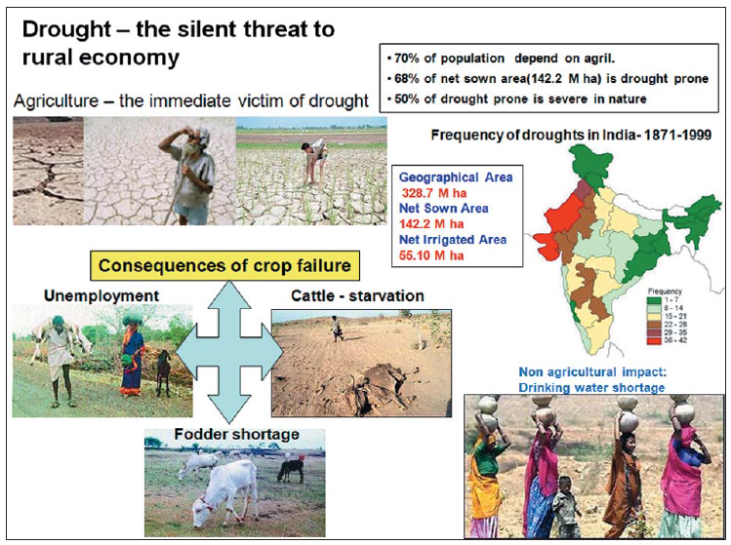
Multi-dimensional Impacts of drought
(Source: Roy et al., 2010)

Slide 22
Impact of Drought
Economic impacts
Refer to production losses in agriculture and related sectors, especially animal husbandry, dairy, poultry, horticulture and fisheries.
It affects livelihoods and quality of life for the majority of farmers, share croppers, farm labourers, artisans, small rural businesses and rural population in general that is dependent on agriculture.
All industries dependent upon the primary sector for raw materials suffer on account of reduced supplies and hardening prices.
Drought thus causes a dampening impact on the economy by squeezing profit margins, drying up income and revenue streams and constricting employment avenues through disruption caused to supply chain managements, slowing down flow of credit and tax collections, depressing industrial and consumer demand, increased dependence on imports, and lowering of overall market sentiments.

Slide 23
Impact of Drought
Environmental impacts can be gauged from
Low water levels in ground water and surface reservoirs, lakes and ponds, reduced flows in springs, streams and rivers, loss of forest cover, migration of wildlife and sharpening man-animal conflicts and general stress on biodiversity.
Reduced stream flow and loss of wetlands may affect levels of salinity. Increased groundwater depletion rates, and reduced recharge may damage aquifers and adversely affect the quality of water (e.g., salt concentration, acidity, dissolved oxygen, turbidity) which in turn may lead to a permanent loss of biological productivity of soils.

Slide 24
Impact of Drought
Social impacts are manifest in widespread disruption in rural society on account of
Outmigration of the population from drought affected areas, rise in school dropout rates, greater immiseration and indebtedness, alienation of land and livestock assets, malnutrition, starvation and loss of social status among the most vulnerable sections. The situation of scarcity in some cases may exacerbate social tensions and lead to erosion of social capital.

Slide 25
Drought management strategy
The causes of drought are essentially due to temporal and spatial aberrations in the rainfal1, improper management of available water and lack of soil and water conservation. Drought management involves development of both short-term and long- term strategies. Short-term .strategies includes early warning, monitoring and assessment of droughts.
The long-term strategies aim at providing drought mitigating measures through proper soil and water conservation, irrigation scheduling and cropping patterns. Figure 5.16 shows some impacts and possible modifications of various drought components. The following is a list of possible measures for making drought prone areas less vulnerable to drought associated problems:

Slide 26
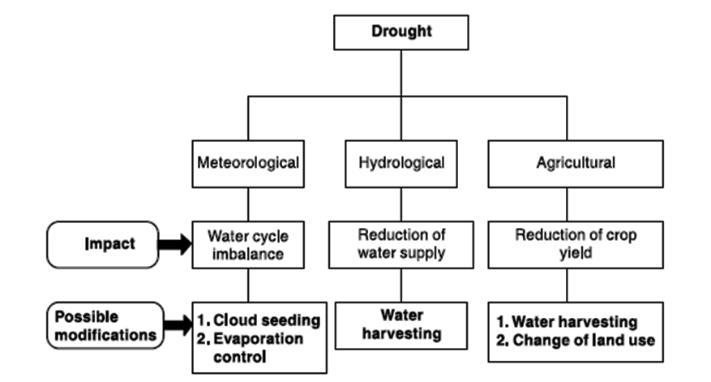
Drought management strategy
Impacts and possible modification of drought components
(Source: Subramanya, 2018)

Slide 27
Drought management strategy
Creation of water storages through appropriate water resources development
Inter-basin transfer of surface waters from surplus water areas to drought prone areas
Development and management of ground water potential
Development of appropriate water harvesting practices
In situ soil moisture conservation measures
Economic use of water in irrigation through practices such as drip irrigation, sprinkler irrigation, etc.
Development of afforestation, agro-forestry and agro-horticulture practices
Reduction of evaporation from soil and water surfaces
Development of fuel wood and fodder
Sand dune stabilization
Drought-proofing of a region calls for integrated approach, taking into account the multi-dimensional interlinkages between various natural resources, environment and local socio-economic factors.
Salient features of water harvesting, which forms an important component in modification of drought components is described in the next sub-section.

Slide 28



Slide 29
References
Eslamian S. (2017) Handbook of Drought and Water Scarcity. Francis and Taylor, CRC Group.
Manual for Drought Management. (2016) Department of Agriculture, Cooperation & Farmers Welfare, Ministry of Agriculture & Farmers Welfare, Government of India, New Delhi.
Roy P. S., Dwidedi R. S., and Vijayan D. (2010) Remote Sensing Applications. National Remote Sensing Centre.
Subramanya, K. (2018). Engineering Hydrology. Tata McGraw-Hill publishing Company Limited.
https://drought.unl.edu/Education/DroughtforKids/Glossary.aspx#:~:text=drought%3A%20less%20rainfall%20than%20is,%2C%20group%2C%20or%20environmental%20sector.
https://serc.carleton.edu/eslabs/drought/drought_glossary.html
https://glossary.ametsoc.org/wiki/Drought

Slide 30
